Slide 1


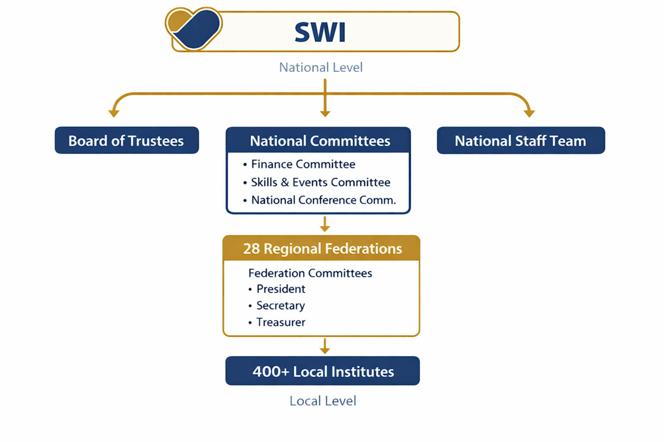
SWI Overview

Slide 2
Session Overview
Presenters
SallyAnn Kelly OBE
Michael Stewart
Our approach
Creating Safe Environments for all
Building Confidence & Reassurance
Enabling Capacity within the SWI
90 minute session
Includes Case studies
Questions and Answers
Notes:
Outline the purpose of the session: creating safe environments, building confidence, and enabling safeguarding capacity across SWI.

Slide 3
Safeguarding Training Briefing
[SWI Logo]
SWI Federations & Institutes
Our commitment to keeping people safe
Safeguarding is everyone’s responsibility
Overview of policy expectations
A focus on key elements of the SWI guidance
Overarching Principle –
Children, Young People & Adults at Risk is everyone who may be involved with SWI
Notes:
Notes:
Highlight that safeguarding is everyone’s responsibility, regardless of role.
Explain that we will focus on key elements of the SWI guidance.
Emphasise the overarching principle: children, young people, and adults at risk include anyone who may be involved with SWI activities.

Slide 4
Key Safeguarding Topics
[SWI Logo]
Definitions:
Children and young people (under 18)
Adults at risk (vulnerable adults)
Abuse and exploitation
Wellbeing principles underpin all safeguarding
Discussion prompt:
Why is safeguarding relevant to SWI activities?
Answer in chat
Notes:
Define key groups: children/young people under 18, and adults at risk.
Clarify what abuse and exploitation mean in practice.
Stress that wellbeing principles underpin all safeguarding decisions.
Explain why safeguarding is relevant to SWI: community engagement, public‑facing activities, and duty of care.

Slide 5
Legal & Practice Framework
[SWI Logo]
Protection of children & adults is underpinned by law and practice guidance.
It applies to all organisations working with members of the public.
Examples include
PVG and safer recruitment
Data protection duties
Getting It Right For Every Child/One principles
Notes:
Briefly outline the legal context: protection of children and adults is grounded in law.
Mention PVG, safer recruitment, and data protection as core responsibilities.
Introduce GIRFEC/One principles as part of Scotland’s safeguarding landscape.
Emphasise that all organisations working with the public must comply.

Slide 6
Organisational Responsibilities
[SWI Logo]
Every organisation needs to develop a response to protecting the people they serve.
Examples include
Policies and procedures
Risk assessments
Training and awareness
Safer recruitment
Reporting systems
Notes:
Explain that every organisation must have a safeguarding response.
Walk through examples: policies, risk assessments, training, safer recruitment, reporting systems.
Reinforce that SWI is strengthening its approach to align with best practice.

Slide 7
Roles & Responsibilities
[SWI Logo]
Duty of all members to prioritise wellbeing
Safeguarding is everyone’s responsibility
Code of Conduct expectations
No one should investigate concerns
Notes:
Reiterate that safeguarding is everyone’s responsibility.
Highlight the Code of Conduct and expectations of behaviour.
Stress that no one should investigate concerns — reporting, not investigating, is the role of members.

Slide 8
Role of the Safeguarding Lead
Discussion- Having reviewed the guidance:
What is your understanding of the role?
What reassures you about the role?
What are your concerns, if any?
What other support from SWI staff is required to implement the guidance?
Answer in chat
Notes:
Introduce the Discussion.
Explain that this is a space to explore the role safely and openly.
Encourage participants to reflect on their understanding of the role.
Prompt discussion on reassurance, concerns, and support needs.

Slide 9
Recognising Abuse & Risk
[SWI Logo]
Main categories of abuse:
Physical abuse
Emotional abuse
Sexual abuse
Financial abuse
Neglect
Common warning signs to look out for (the above are examples of the breadth of situations that these can apply to)
Trust your concerns and report
Notes:
Walk through the main categories of abuse.
Provide examples of warning signs — behavioural, emotional, physical.
Encourage participants to trust their instincts and report concerns.
Reinforce that noticing something is enough; certainty is not required.
.

Slide 10
Responding to Concerns
[SWI Logo]
If someone discloses abuse or exploitation, or you suspect a concern:
Stop and listen – take the allegation seriously – keep calm
Encourage them to talk, in their own words, encourage them to share their experience, but don’t question or seek clarifications.
Never promise confidentiality – explain you must tell those who need to know
Record accurately using their own words (note time, location, who was present)
Do not confront the alleged abuser
Report – it is NOT your responsibility to investigate
Notes:
Outline the steps when someone discloses or you suspect abuse.
Emphasise listening, not questioning.
Explain why confidentiality cannot be promised.
Stress the importance of accurate recording.
Reinforce: do not confront the alleged abuser; report immediately.

Slide 11
How to Report Concerns
[SWI Logo]
When to report? Immediately. Do not delay.
How to report? In person, by phone, or via secure written channel (e.g. encrypted email)
Who to report to?
Immediate risk of harm → Contact police/medical/social services + inform Safeguarding Lead
No immediate risk → Report to Safeguarding Lead (or office-bearer if Lead is unavailable/implicated) (within 24 hours)
What to include:
Nature of concern • Date, time & place • Exact wording used • Names & roles • Actions taken so far
Notes:
Clarify when to report: immediately.
Explain who to report to depending on risk level.
Highlight secure communication methods.
List the essential information to include in a report.
Reinforce that timely reporting protects everyone.

Slide 12
Case Study 1
[SWI Logo]
You are supporting a craft session with a small group of young people, and you overhear a young person talk about feeling bullied and being asked to send inappropriate pictures to someone at school.
What do you do?
Answer in chat
Notes:
Encourage participants to identify safeguarding concerns: bullying, coercion, inappropriate image requests.
Ask: What steps would you take?
Reinforce the reporting pathway and the importance of not investigating.
Highlight digital safety as a growing area of concern.

Slide 13
Case Study 2
[SWI Logo]
Adult appears distressed at event she states
“ he didn’t want me to come tonight he made it very difficult for me to be here, I’m worried about what kind of reception I’ll get when I get home“
Does this scenario concern you?
How do you respond?
Answer in chat
Notes:
Explore indicators of domestic abuse: fear, control, distress.
Ask participants how they would respond safely and supportively.
Reinforce that adult safeguarding is equally important.
Emphasise the need to report concerns even when unsure.

Slide 14
Reporting to SWI
[SWI Logo]
SWI must be notified when a concern:
Has been referred to external authorities
Involves allegations against staff, volunteers or trustees
Could impact reputation, operations or legal obligations of SWI group
Notify SWI within 24 hours of the concern being raised
Share anonymised information only – comply with UK data protection legislation
Provide regular updates: investigation progress, actions taken, outcomes
Notes:
Explain when SWI must be notified: external referrals, allegations against SWI personnel, reputational or operational risk.
Stress the 24‑hour notification requirement.
Highlight anonymisation and data protection.
Reinforce the need for ongoing updates.

Slide 15
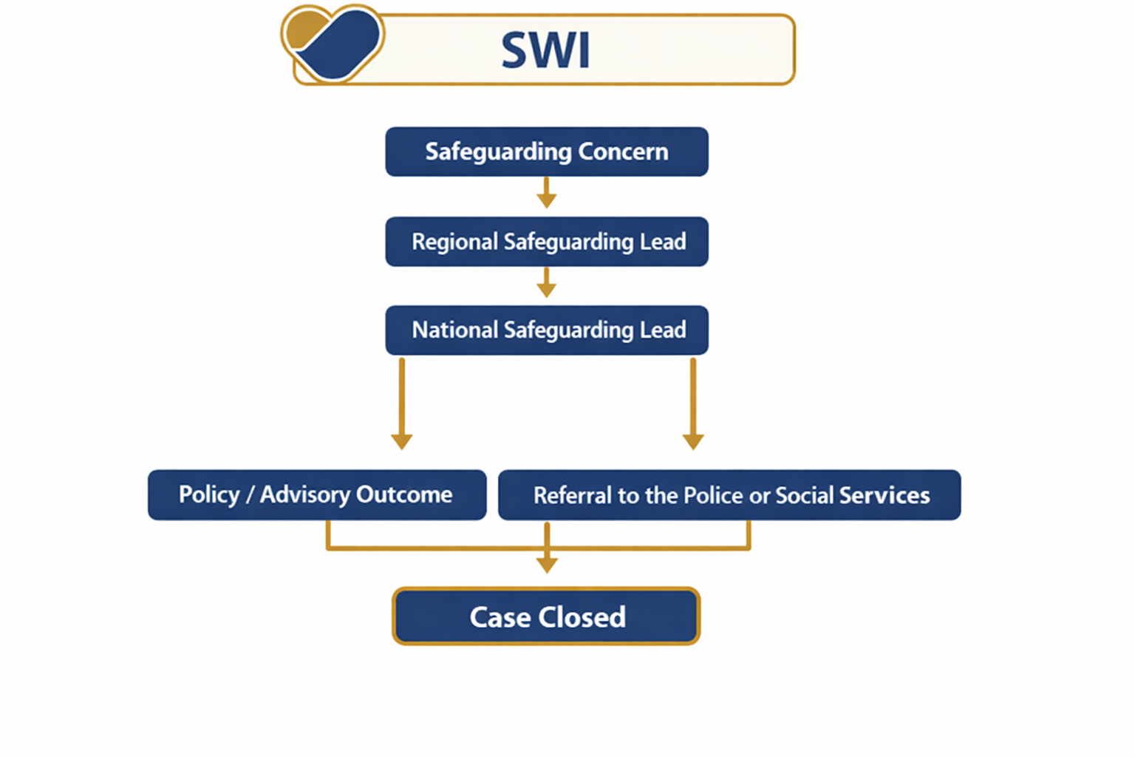
Reporting to SWI
Notes:
Explain when SWI must be notified: external referrals, allegations against SWI personnel, reputational or operational risk.
Stress the 24‑hour notification requirement.
Highlight anonymisation and data protection.
Reinforce the need for ongoing updates.

Slide 16
Internal Process
[SWI Logo]
Within 24 hours, the Safeguarding Lead must:
Review the concern
Refer to relevant Federation Executive Committee and agree next steps, including if an immediate suspension of the volunteer is required.
Consult with relevant external authorities where required
Agree and record next steps and record all actions taken
Inform office-bearers, Federation (if applicable) and SWI
Consider whether other parties need to be informed (e.g. grant providers)
Notes:
Outline the Safeguarding Lead’s responsibilities within 24 hours.
Explain temporary suspension of activities where necessary.
Emphasise recording decisions and actions.
Note the importance of informing relevant office‑bearers and SWI.
Mention wider stakeholders such as funders if relevant.

Slide 17
Whistleblowing
[SWI Logo]
We encourage a culture of openness and accountability
If you believe safeguarding procedures are not being followed:
Raise concerns with the Safeguarding Lead
Or contact the NSPCC Whistleblowing Advice Line directly
NSPCC Whistleblowing Advice Line:
Phone: 0800 028 0285
Email: help@nspcc.org.uk
Notes:
Encourage a culture of openness and accountability.
Explain what to do if safeguarding procedures are not being followed.
Advise that SWI are in the process of developing the organisational whistleblowing procedure, and that a further briefing around this will be developed.
Provide NSPCC Whistleblowing Advice Line details.
Reinforce that raising concerns is a protective action, not a punitive one.

Slide 18
Key Messages & Close
[SWI Logo]
Safeguarding is everyone’s responsibility
Report concerns promptly – do not delay
When in doubt, pass it on
Know where to find the policy and support
Notes:
Summarise the core messages: safeguarding is everyone’s responsibility; report promptly; when in doubt, pass it on.
Encourage participants to familiarise themselves with the policy and support routes.
Reinforce that safeguarding strengthens the organisation and protects members.

